Slide 1
Fundamentals of IoT Software © 2021 by Luca Mottola is licensed under CC BY-NC 4.0
To view a copy of this license, visit creativecommons.org/licenses/by-nc/4.0/

Slide 2

Fundamentals of
IoT Software
Going into Production
Luca Mottola luca.mottola@polimi.it
(version 0.1)

Slide 3
The Bigger Picture…
What seen so far are methods, platforms, and software support for rapid IoT software prototyping
  Essentially one phase in an IoT product
  development process

Slide 4
IoT Development Process

Slide 5
Backend Integration
Requires more “traditional” expertise and knowledge
  Based on resource-rich platforms, high-level languages and tools
IoT backend platforms exist aplenty nowadays
  Commercial and open-source
  Targeting the edge or the cloud, or both…

Slide 6
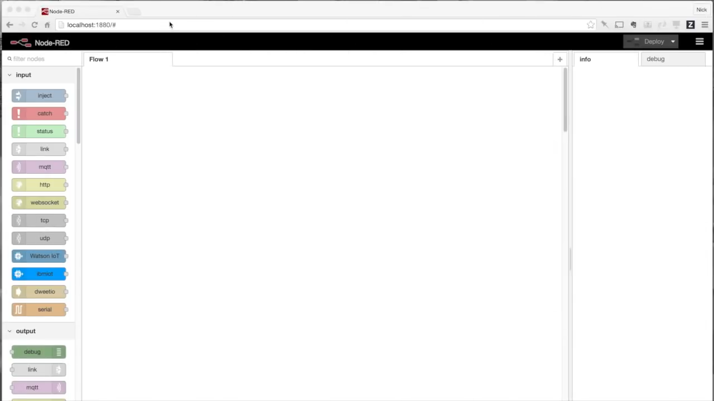
Node-RED

Slide 7
Node-RED and MQTT

Slide 8
Microsoft Azure

Slide 9
Custom Hardware
Development boards are typically open-source hardware
  Bill of materials and schematics are available
Examples:
TI schematics
and Mbed HDK

Slide 10
Software Verification
Happens through professional
development environments
  IAR Workbench, uVision Kjiel, …
Both Contiki-NG and Mbed can export towards many of them
May represent a vast fraction of development efforts overall

Slide 11

Product Release

Slide 12
Conclusion
Goal of the course was to teach
embedded IoT software for real
  Connect concepts across different systems
  Learn concepts and techniques by doing
  Appreciate the practical difficulties
Of course, we only scratched the surface…
… but hopefully provided a basis for you to build upon!

Slide 13
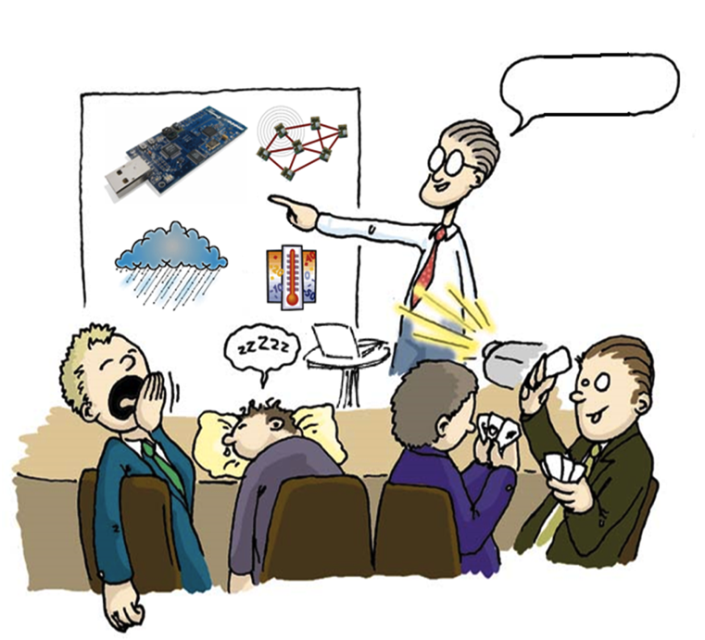
Questions?

