Slide 1
Fundamentals of IoT Software © 2021 by Luca Mottola is licensed under CC BY-NC 4.0 To view a copy of this license, visit creativecommons.org/licenses/by-nc/4.0/

Slide 2
Fundamentals of IoT Software Contiki-NG Shell Luca Mottola luca.mottola@polimi.it (version 0.1)

Slide 3
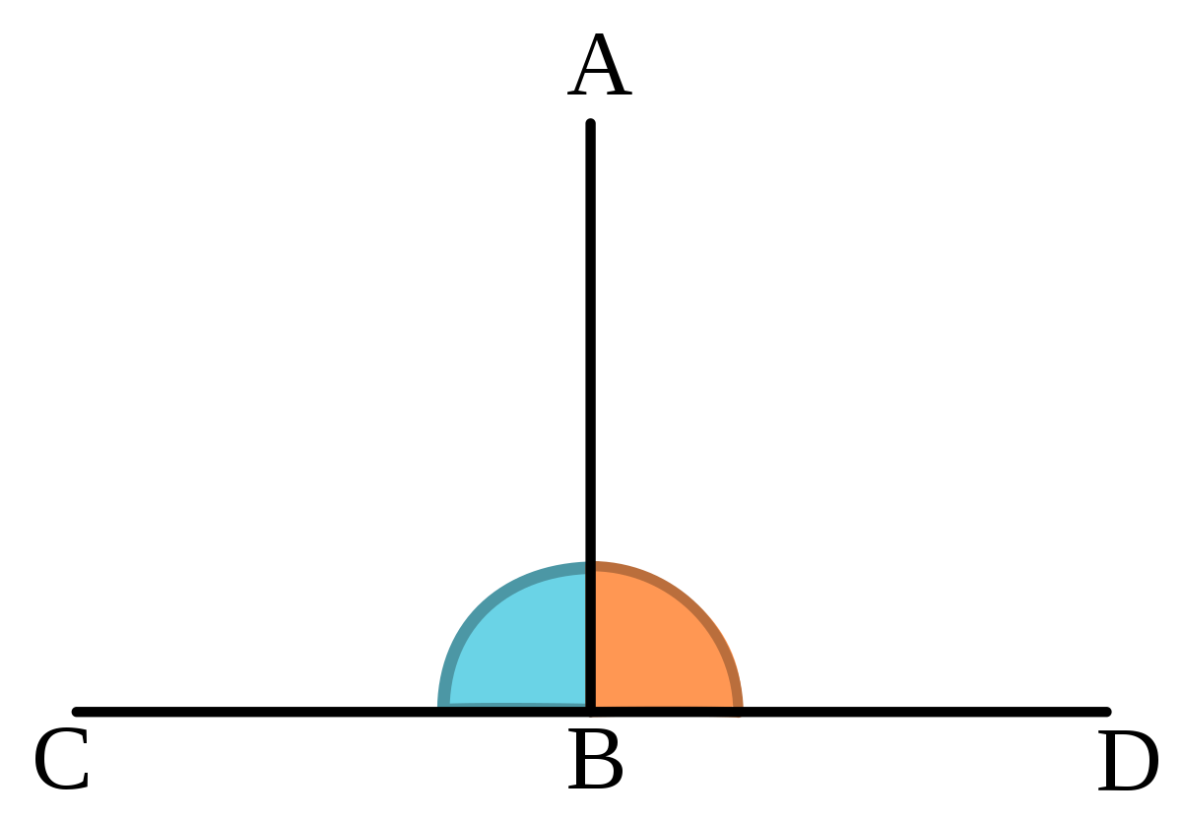
Orthogonality
A small set of primitives
…to be combined in a small number of ways
…to build control and data flows
Paradigmatic example: the Linux shell
Small set of commands
Operators to combine them (pipes, redirects, …)
Can build complex data processing pipelines!

Slide 4
The Contiki-NG Shell (1)
Contiki has a (primitive) shell one can access from the serial line
Adding the shell to an existing project only requires to modify the Makefile by adding
MODULES += os/services/shell
The set of available commands changes depending on the modules part of the project

Slide 5
The Contiki-NG Shell (2)

Slide 6
Some Useful Commands
ip-addr: current IP address(es) of the node
ip-nbr: current (1-hop) neighbors
log <module> level: changes log levels
rpl*: manipulates RPL
ping: you know this…
…
You can create your own!
Look under os/services/shell

Slide 7
Notes:
DIRECTIONS FOR INSTRUCTORS:
Compile examples/blink-shell and upload
Access the shell, look at available commands
Use ip-addr to get local IP
Ping some other node, check the neighbor table using ip-nbr
Now one node can do rpl-set-root 1 and then run rpl-status and routes

